Slide 1

UK TRAIN RIDES
Prepared by: Data Wizards

Slide 2
Team Members
Majid Ashraf Abd Elmajed
Mostafa Hossam Esmail
Mohamed Khaled Mohamed
Basmala Khaled Kamal
Nada Ahmed Nour

Slide 3
Introduction
​In the dynamic landscape of the United Kingdom's rail network, understanding passenger behavior and operational efficiency is paramount
This data aims to support the analysis of train performance over time, understand the causes of delays, and identify potential passenger behavior and preferences based on purchase methods.
It captures a wealth of information, including payment methods (online versus station purchases), ticket pricing based on departure and arrival stations, journey durations, delay statuses with corresponding reasons, and the presence or absence of refund requests.

Slide 4
Business Questions
Passenger Satisfaction and Experience
What is the overall passenger satisfaction score for the period?
Which stations or routes receive the most customer complaints or praise?
What are the most common reasons for passenger dissatisfaction?
Operational Efficiency
What is the average turnaround time for trains at major stations?
How does train occupancy compare across different times of day or routes?
What is the average speed of trains by route or service type?

Slide 5
Revenue & Ticketing
Which ticket type (Advanced, Off-Peak, Anytime) generates the highest revenue?
What percentage of tickets are purchased online versus at stations?
What is the average revenue per trip?
How does revenue vary by ticket type and time of purchase?
Customer Behavior
What is the average spending per customer?
What is the distribution of ticket types purchased?
Is there a correlation between purchase channel (online/station) and ticket type?

Slide 6
Punctuality & Service Performance
What percentage of trains arrive on time compared to delayed and cancelled trains?
What are the key causes of service delays and cancellations, and how can we prioritize efforts to reduce them?
What are the train routes with the most delays?
What is the average delay time per route?
Market and Growth
How has market share changed compared to other modes of transport?
What is the growth rate in passenger numbers or revenue year-over-year?

Slide 7
Methodology
Data Cleaning and preparation:
Handling Missing or Invalid Values
Standardizing Data Formats
Creating Derived Columns
Merging Tables
Data Modelling:
Defining Relationships
Implementing DAX Measures
Optimizing Performance

Slide 8
Visualization & Analysis:
Delay & Refund Analysis
Passenger Behavior
Total Revenue & Transactions Analysis
on time trips

Slide 9
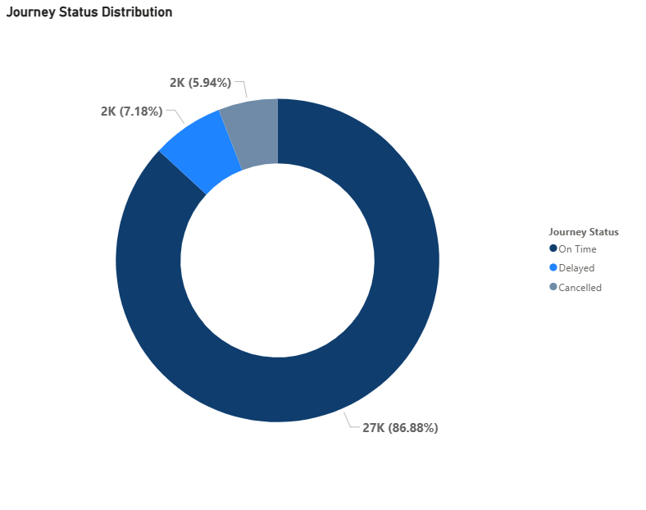
Milestone Achieved
Most trips (89.85%, or 28,752 trips) were completed on time — a strong indicator of operational efficiency.
Around 11% of all trips faced delays or cancellations (a total of 3,558 trips), which still presents room for improvement.

Slide 10
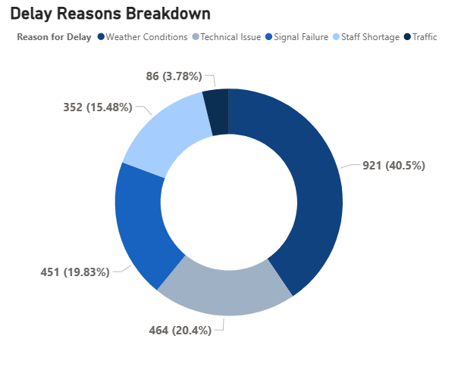
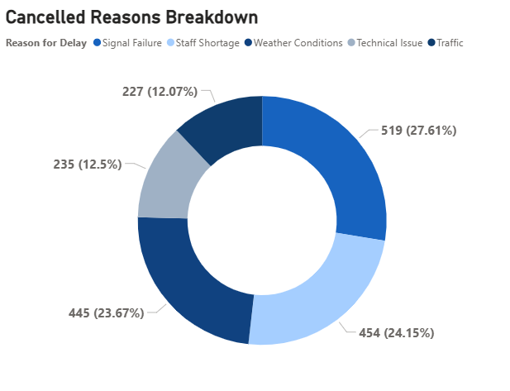
Trips Obstacles
Weather Conditions are the major cause for both delays and cancellations, showing how significant environmental factors are.
Technical Issues are consistently impactful across both metrics.
Traffic and Staff Shortage have moderate effects on both delays and cancellations, but never the highest.
Organizations should focus on improving weather resilience and system maintenance to reduce both delays and cancellations

Slide 11
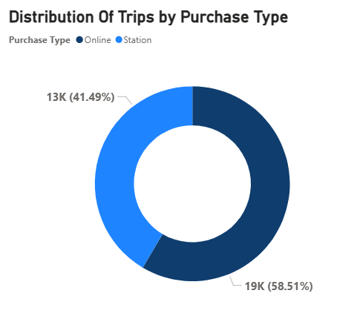
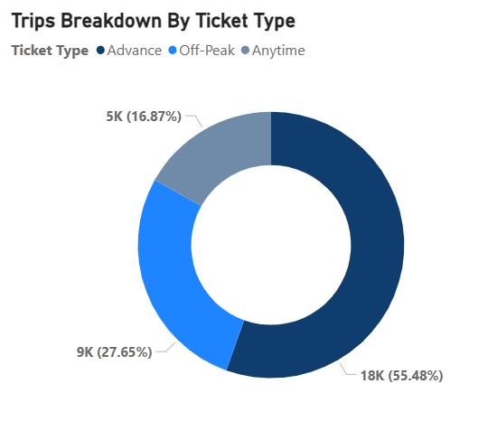
Trips Avenue
Most tickets (58.5%) were purchased online, showing a strong digital adoption.
Advance tickets are the most popular (55.48%), followed by Off-Peak (27.65%) and Anytime tickets (16.87%)
Anytime and Off-Peak ticket types make up the rest, which are often chosen for cost-saving purposes.

Slide 12
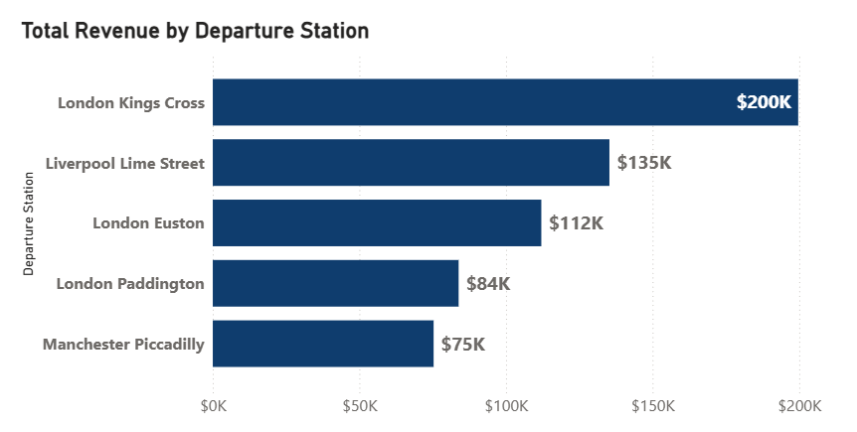
Leading Stations
London Kings Cross generated the highest revenue at $200K, leading by a large margin..
Liverpool Lime Street and London Euston performed moderately, with $135K and $112K respectively.
London Paddington and Manchester Piccadilly generated less than $85K.

Slide 13
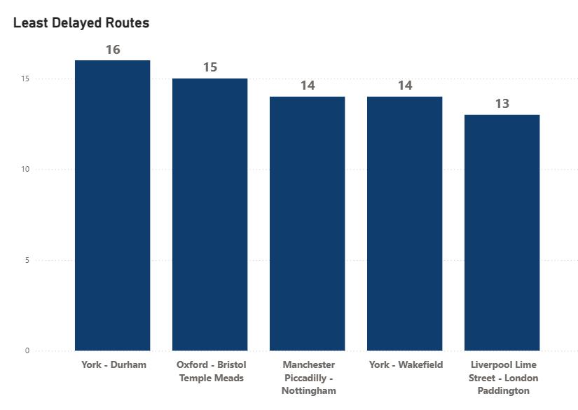
Set-back Stations
York - Durham with 16 delayed trips.
Oxford - Bristol Temple Meads with 15 delayed trips
Manchester Piccadilly - Nottingham with 14 delayed trips
York - Wakefield with 14 delayed trips.
Liverpool Lime Street - London Paddington with 13 delayed trips.

Slide 14
Synopsis
1. Severe weather significantly impacts punctuality and reliability.
2. Performance varies widely between stations; some operate as models of efficiency while others face ongoing challenges.
3. This high-demand route exhibits both strong performance and major service failures, reflecting inconsistency.
4. There is an opportunity to grow revenue by promoting Railcards and enhancing Standard Class experiences.
5. Infrastructure failures significantly extend delay durations.
6. Purchase Type: 58.51% of tickets are purchased online, showing a preference for convenience.
7. Ticket Types: Advance tickets are the most popular (55.48%), followed by Off-Peak (27.65%) and Anytime tickets (16.87%).

Slide 15
Recommendations
1. Develop proactive contingency plans and enhance forecasting systems to mitigate weather-related disruptions.
2. Benchmark best practices from Manchester Piccadilly and apply them to lower-performing stations like Liverpool Street.
3. Conduct in-depth route-specific audits to identify causes of cancellations and passenger dissatisfaction.
4. Correlate refund rates with delay patterns to drive service improvement and reduce financial leakage.
5. Prioritize preventive maintenance and invest in signal system upgrades to minimize long delays.
6. Enhance Online Booking Platform: Improve the user experience of the online booking system and develop a mobile application.
7. Optimize Ticket Offerings: Continue offering discounts for advance tickets and introduce more flexible ticket options.

Slide 16
Conclusion
By analyzing delay patterns, the project helps identify areas for improvement, such as better scheduling, infrastructure upgrades, and operational efficiency. Understanding these trends allows stakeholders to develop strategies that enhance overall service quality and passenger satisfaction.

Slide 17
Thank you

